Slide 1
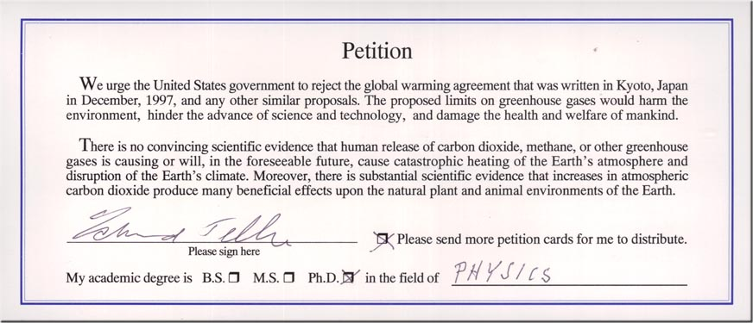
31,487 American scientists have signed this petition. Nearly 1 in every 3 people who signed this has a Ph.D degree.

Slide 2
Al Gore’s ‘An Inconvenient Truth”
35 ERRORS MADE
Error 1: Sea level "rising 6 m”
Gore says that a sea-level rise of up to 6 m will be caused by the melting of either West Antarctica or Greenland. In the next 100 years, according to calculations based on figures in the IPCC’s 2007 report, these two ice sheets together will add a little over 6 cm sea-level rise on existing populations. Gore has accordingly exaggerated the official sea-level estimate by approaching 10,000 per cent.
Error 8: Polar bear "dying”
Gore quotes that global warming is the cause of many sea creatures such as polar bears dying. He said that huge amounts of polar bears are dying due to the long trek of a swim they have to do due to the lack of frozen ice left in the arctic ocean. This is incorrect, 4 polar bears died, and they died in an exceptional storm, with high winds and waves in the Beaufort Sea.
Error 18: Arctic "warming fastest”
Gore says the Arctic has been warming faster than the rest of the planet. It is not. Gore does not mention that the Arctic has been cooling over the past 60 years, and is now one degree Celsius cooler than it was in the 1940s. There was a record amount of snow cover in the Northern Hemisphere in 2001. Several vessels were icebound in the Arctic in the spring of 2007, but few newspapers reported this.
http://scienceandpublicpolicy.org/monckton/goreerrors.html

Slide 3
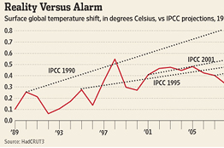
Temperature Shifting
From the graph it appears that the projections exaggerate, substantially, the response of the earth's temperature to CO2 which increased by about 11% from 1989 through 2011. Furthermore, when one examines the historical temperature record throughout the 20th century and into the 21st, the data strongly suggest a much lower CO2 effect than almost all models calculate.
http://online.wsj.com/news/articles/SB10001424052970203646004577213244084429540
(second link) http://wattsupwiththat.com/2013/10/23/getting-very-close-to-meeting-santers-17-year-warming-test/

Slide 4
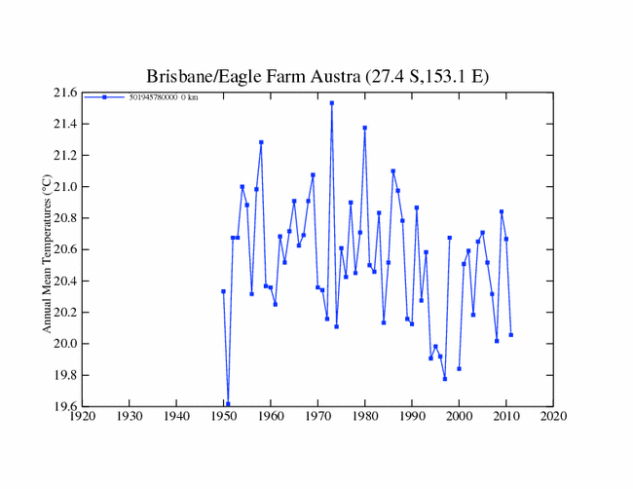
Scientists Changing Statistics
GHCN (national climatic data center) caught out
Before changed (correct data):
Decreasing rapidly after 2007.

Slide 5
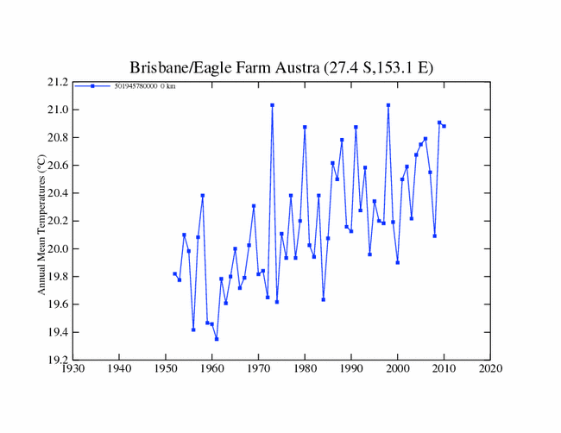
After changed (incorrect data):
Rising rapidly after 2007.

Slide 6
Alaska Glaciers Growing 2007-2008
Never before in the history of a research project dating back to 1946 had the Juneau Icefield witnessed the kind of snow buildup that came this year. It was similar on a lot of other glaciers too.
"It's been a long time on most glaciers where they've actually had positive mass balance," Molnia said.
http://www.mcclatchydc.com/2008/10/14/53884/alaska-glaciers-grew-this-year.html

Slide 7
Sea Level Rise has Decelerated
Global sea level rise has decelerated by 44% since 2004 to a rate equivalent to only 7 inches per century. According to the authors, global mean sea level rise from 1993-2003 was at the rate of 3.2 mm/yr, but sea level rise "started decelerating since 2004 to a rate of 1.8 ± 0.9 mm/yr in 2012.
THE HOCKEY SCHTICK: New paper finds sea level rise has decelerated 44% since 2004 to only 7…

Slide 8
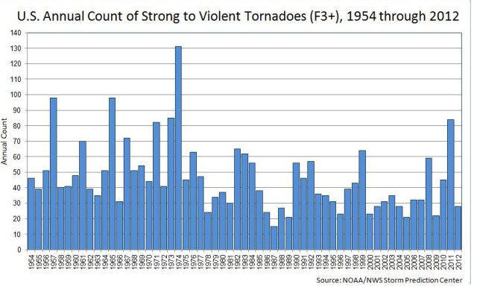
Global Warming = “Natural Disasters”
This year (2013) had the fewest tornadoes on record in the US, and the second fewest number of severe tornadoes, with seventeen.
No consistent pattern of severe tornadoes are happening due to “global warming”. Proved in this graph:
2012
1954

Slide 9
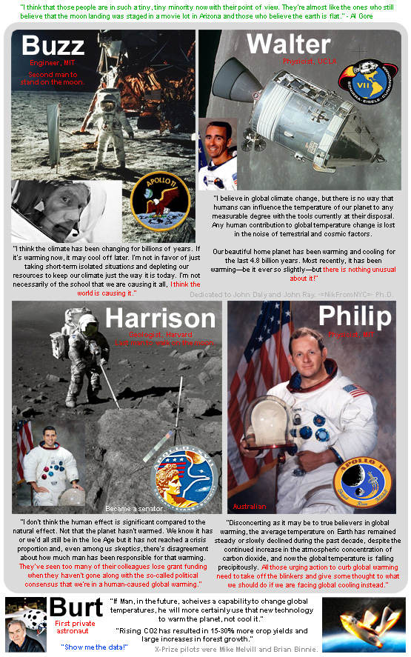
Opinions:

Slide 10
Videos
http://www.youtube.com/watch?v=DDwYLPNHk_0&feature=relmfu
http://www.youtube.com/watch?v=Cl4Pz1mwBao
http://www.gripnw.com/Audio/iSpy11122011_SkepticPt1.mp3
http://www.youtube.com/watch?v=lyRKK4iMrEw

